Slide 1
1. Mohammed Faisal Khan 2. Shaikh Faraaz Abdul Jabbar 3. Sampada Shankar Dudhane 4. Monika Prakash Kondalwade 5. Mrunmayee Khapariye 6. Abhijeet Thorat 7. Mukesh
HOTEL RATING CLASSIFICATION
P – 178 : GROUP 2

Slide 2
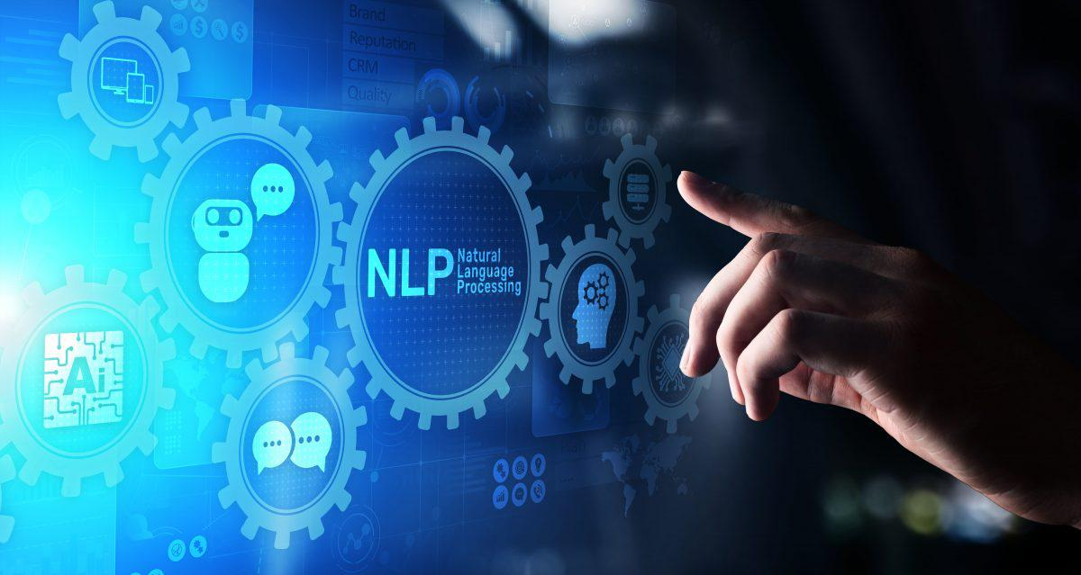
PROJECT ON HOTEL RATING CLASSIFICATION
Text Mining is the process of deriving meaningful information from natural language text

Slide 3
1. Dataset: Hotel_Reviews

Slide 4
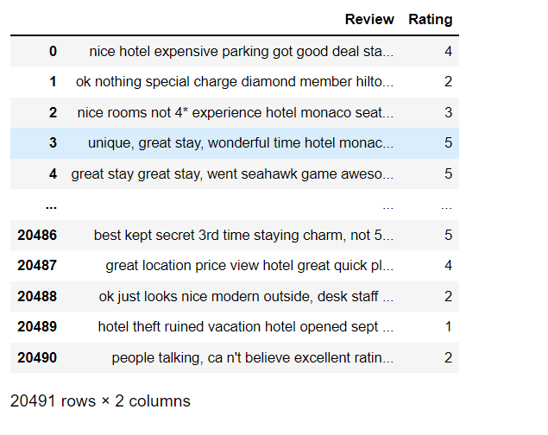
The Overall Goal is to turn the texts into data for analysis via application of Natural Language Processing (NLP)

Slide 5
2. Data Understanding

Slide 6
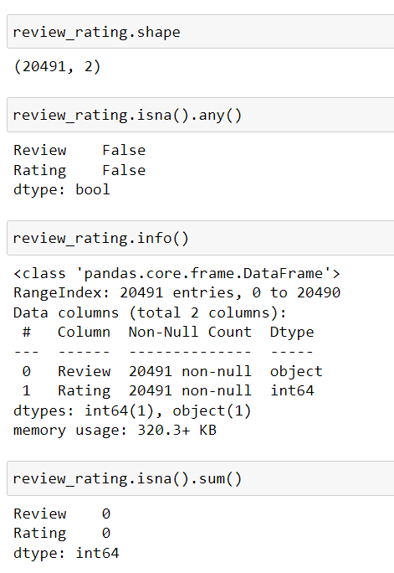
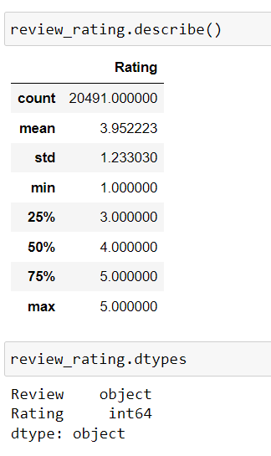
2.1 Initial Analysis :

Slide 7
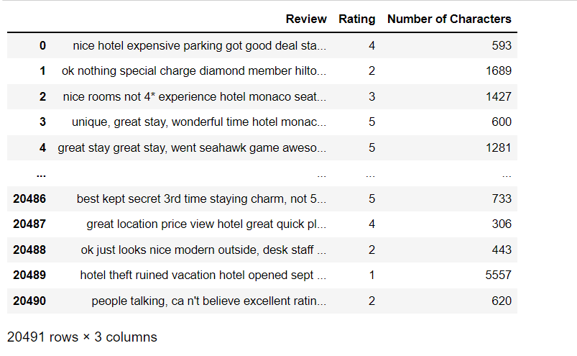
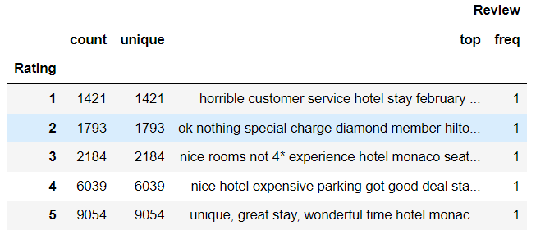

Slide 8
3. AnAlySing text statistics
Text statistics visualizations are simple but very insightful techniques and those really helps to explore the fundamental characteristics of the text data.

Slide 9
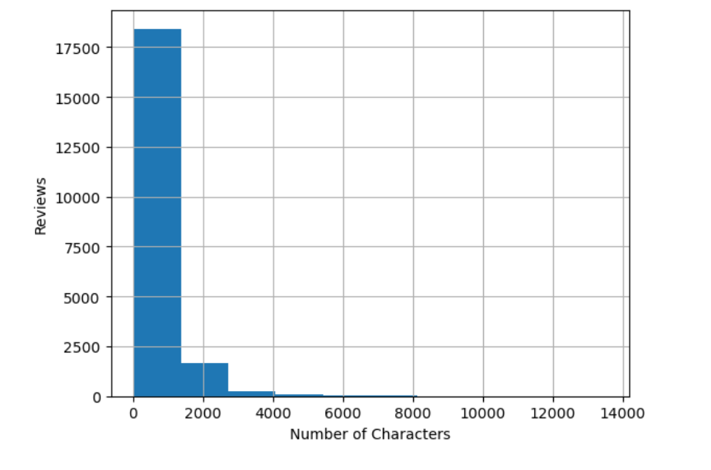
3.1 Number of Characters Present in Each Sentence of Reviews :
The histogram shows that Hotel Reviews range from 1 to 6000 characters and generally more it is b/w 1 to 2000 characters.

Slide 10
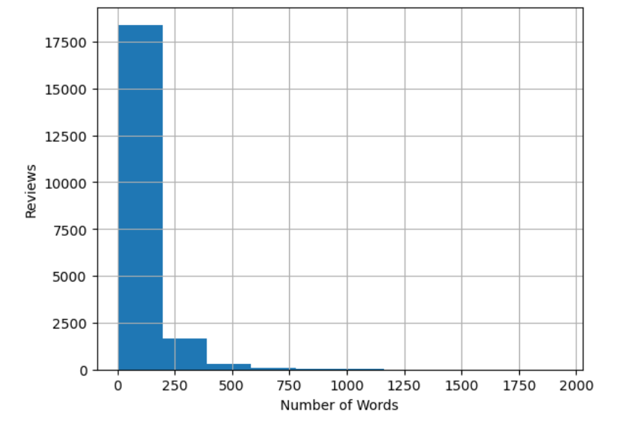
3.2 Number of Words Appearing in Each Hotel Reviews :
It is clear that the number of words in Hotel Reviews ranges from 1 to 750 and mostly falls b/w 1 to 250 words.

Slide 11
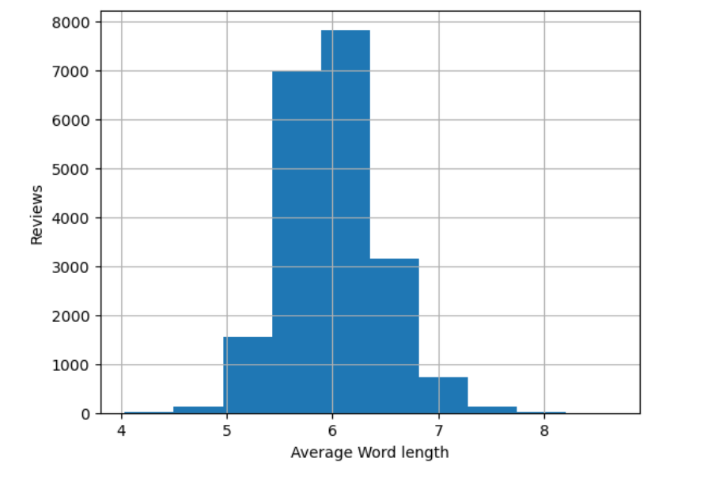
3.3 Check the Average Word Length in Each Sentence :
The average word length ranges b/w 4 to 8 with 6 being the most common length it means that people are using really short words in Hotel Reviews. Now lets find out!

Slide 12
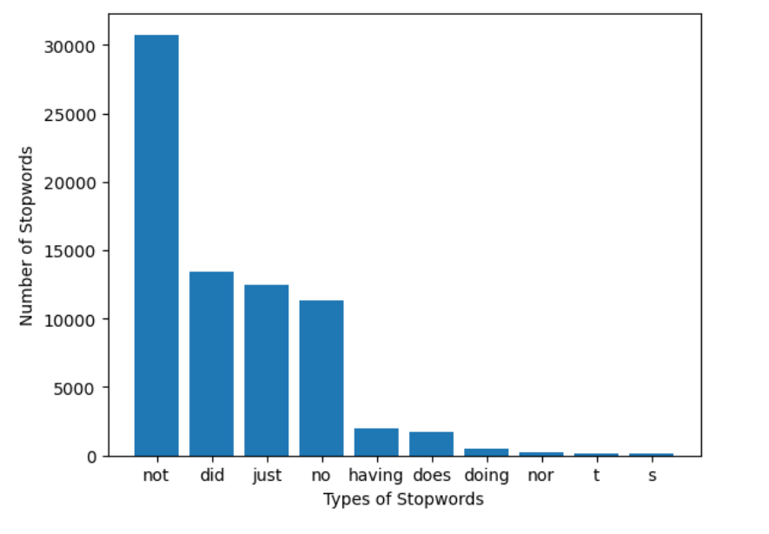
3.4 Analyzing the Amount and the Types of Stopwords :
We can evidently see that stopwords such as 'not', 'did', 'just' and 'no' dominate in Hotel Reviews. So now we know which stopwords occur frequently in our text now lets inspect which words other than these stopwords occur frequently.

Slide 13
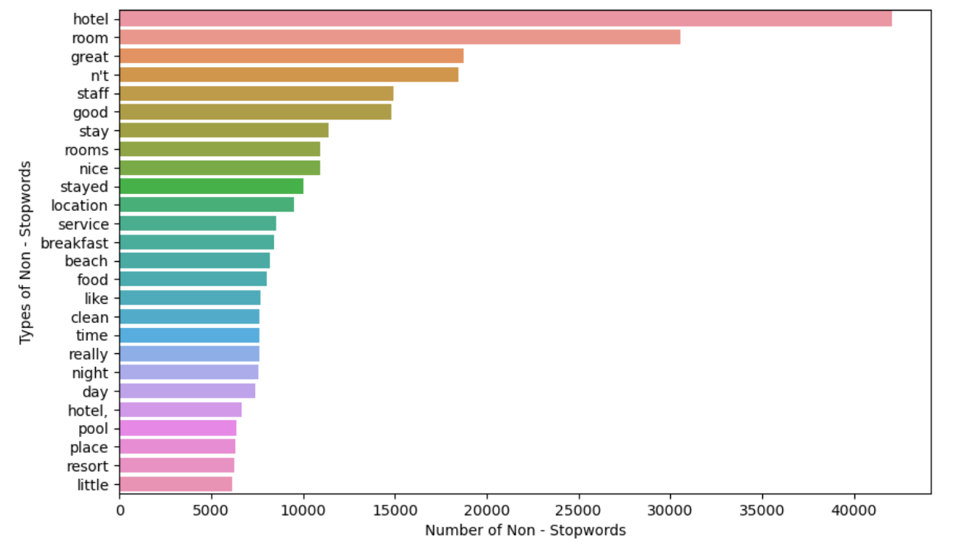
3.5 Word - Level Analysis :
The 'Hotel', 'room', 'great', 'staff' etc. dominate the most words used by customers while giving the Hotel Reviews.

Slide 14
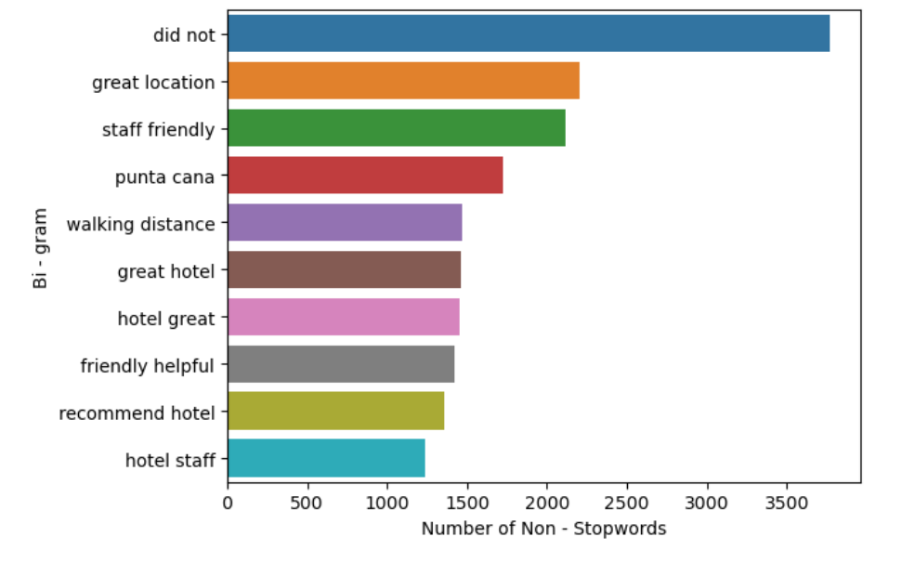
3.6 Ngram Exploration :
A) 2 Words = Bigram
We can observe that the bigrams such as 'great location', 'staff friendly' that are related to Hotel dominate the Hotel Reviews.

Slide 15
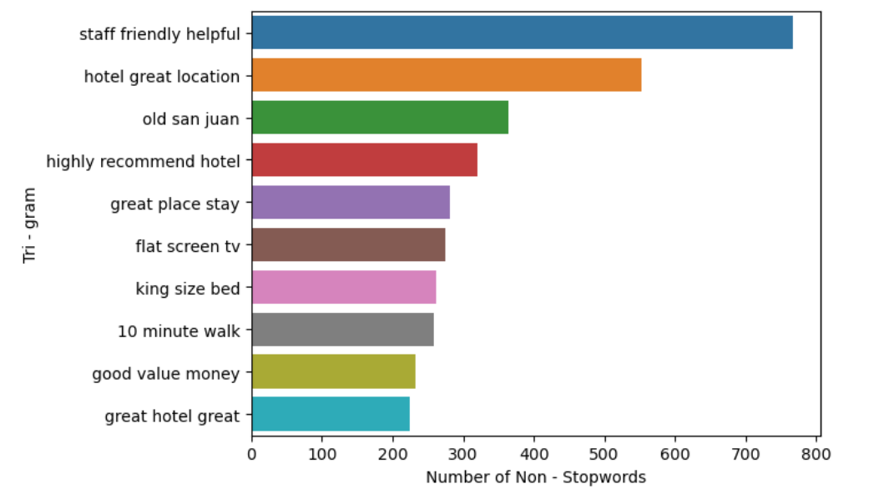
B) 3 Words = Trigram
We can observe that the bigrams such as 'staff friendly helpful', 'hotel great location' that are related to Hotel dominate the Hotel Reviews. It means that we should do some data cleaning Process and see if we are able to combine those related terms into one clean token.

Slide 16
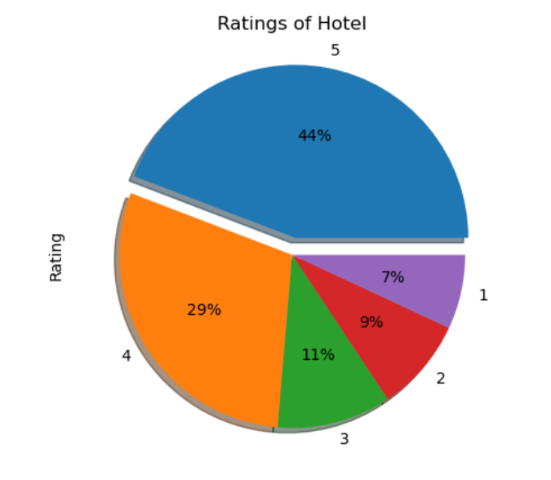
3.7 Visualizing Hotel Ratings Using Pie Chart :
From the above pie chart as we can see that the Highest ratings for a Hotel from customers had got Rating of 5 Stars with 44% and Rating of 4 Stars with 29%.

Slide 17
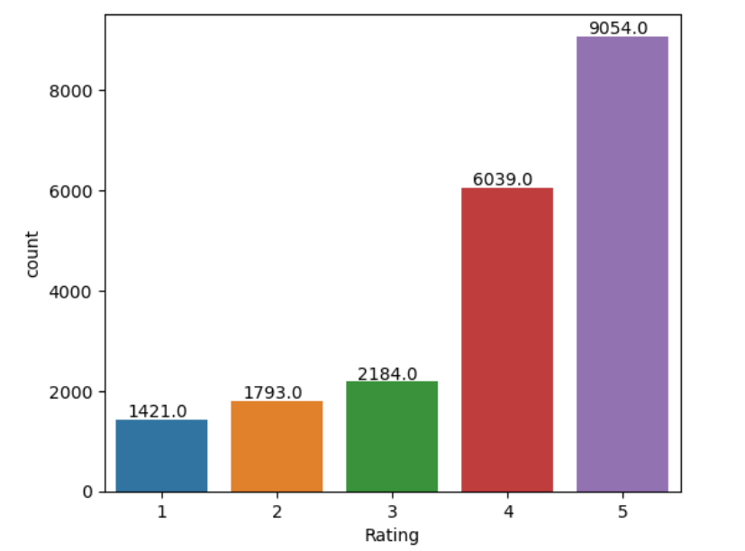
3.8 Visualizing Hotel Ratings Using Countplot :
From the given countplot as we can see that the 9054 customers had given rating 5 star and 6039 customers had given stars.

Slide 18
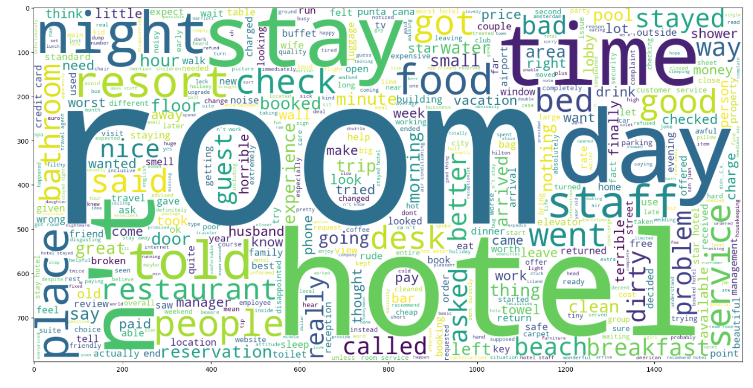
3.9 Generating Word Cloud For Hotel Rating :
A) For 1 Star Rating :

Slide 19
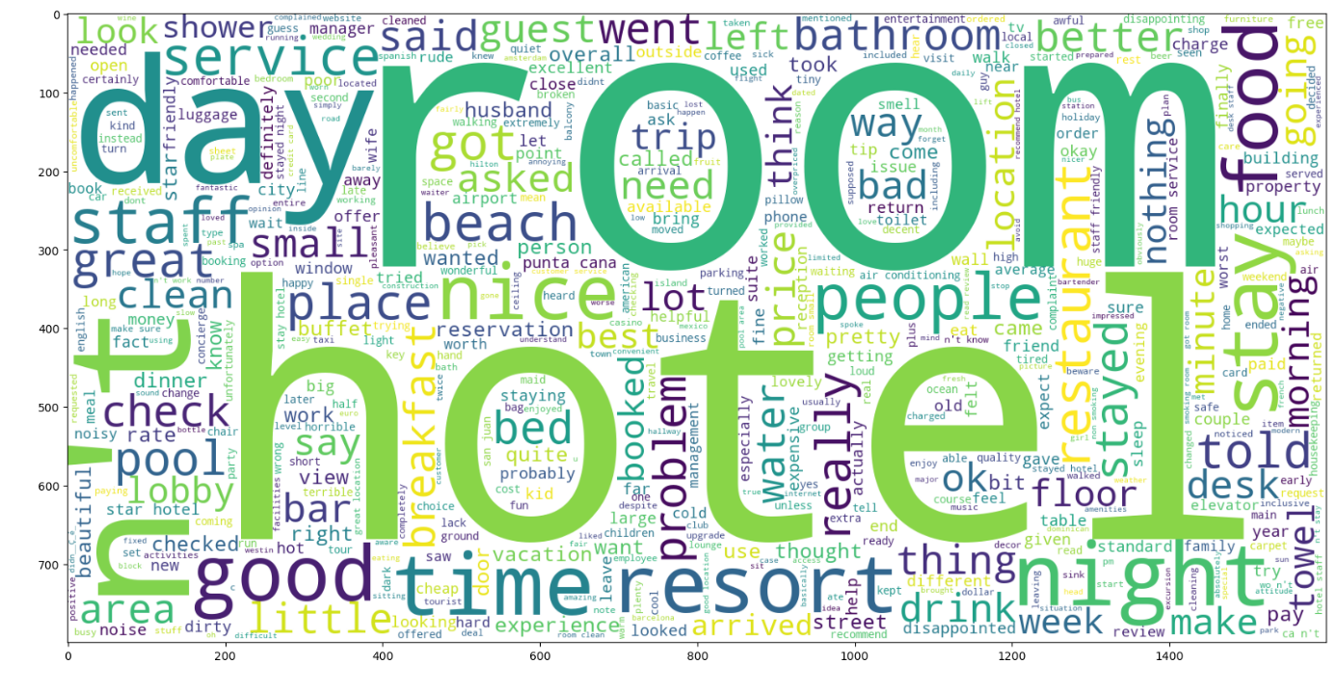
B) For 2 Star Rating :

Slide 20
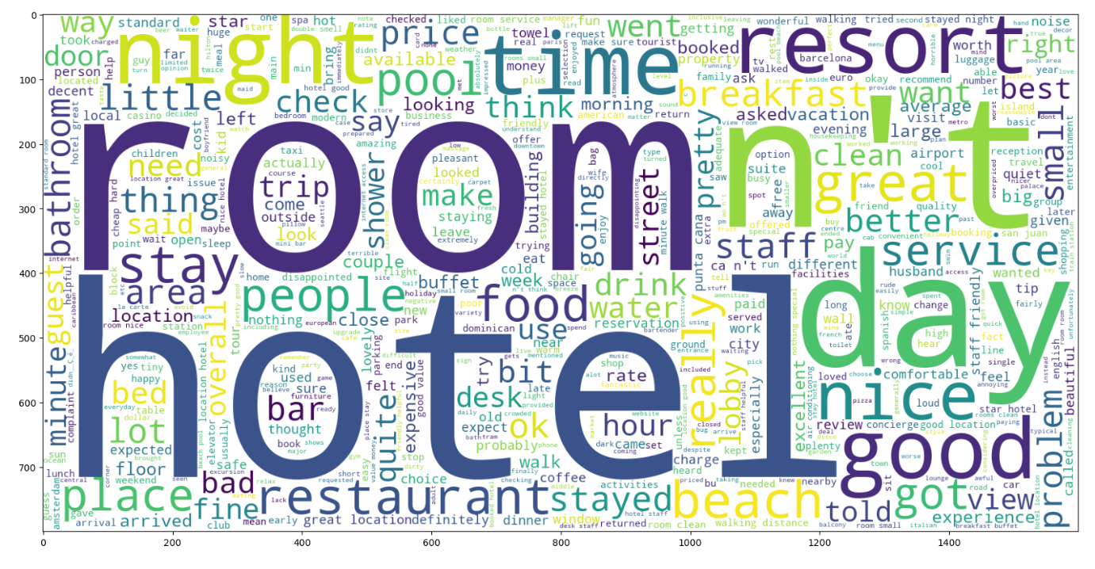
C) For 3 Star Rating :

Slide 21
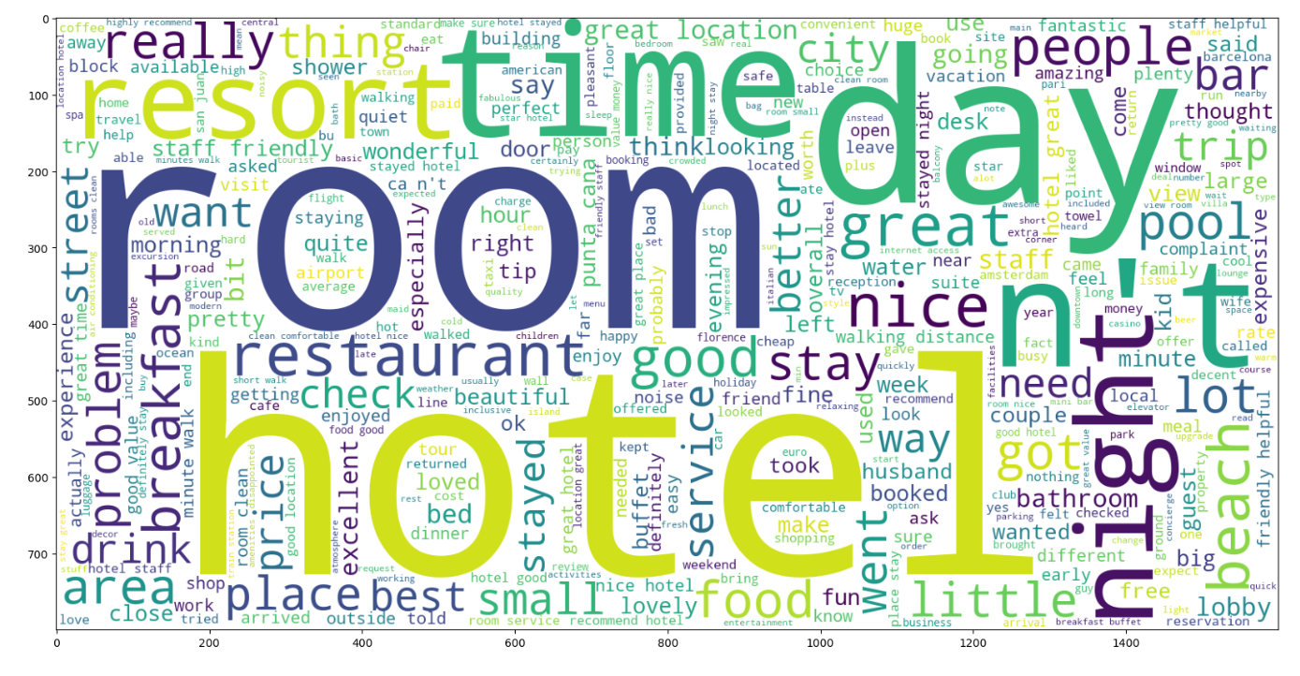
D) For 4 Star Rating :

Slide 22
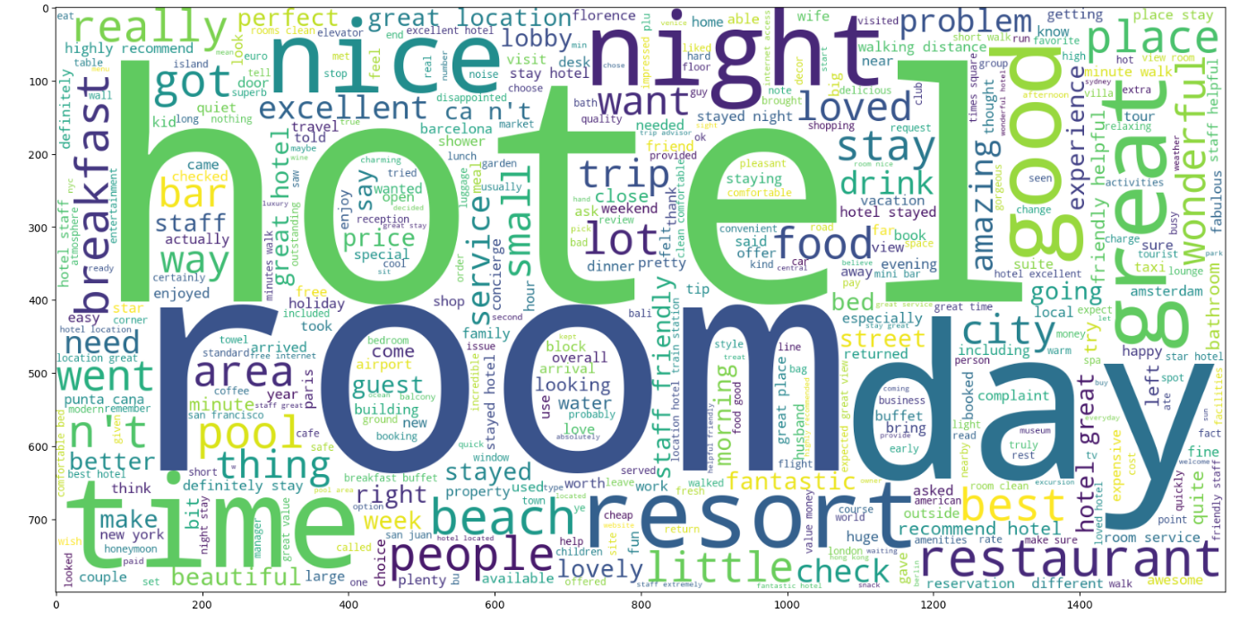
E) For 5 Star Rating :

Slide 23
4. Text Pre processing
Cleaning or preprocessing the data is as important as model building if not more and when it comes to unstructured data like text this process is even more important.

Slide 24
STEP 1 = Lower Casing
STEP 2 = Removal of Punctuations
STEP 3 = Removal of Stop Words
STEP 4 = Removal of Frequent Words
STEP 5 = Removal of Rare Words
STEP 6 = Removal of Numbers
STEP7 = Removal of White Spaces
STEP 8 = Removal of Single Characters
STEP 9 = Removal of Emojis
STEP 10 = Convert Accented Characters to ASCII Characters
STEP 11 = Converting Chat Conversion Words to Normal Words
STEP 12 = Lemmatization & Tokenization
STEP 13 = Converting List to String

Slide 25
5. Cleaned Reviews with Number of Characters

Slide 26
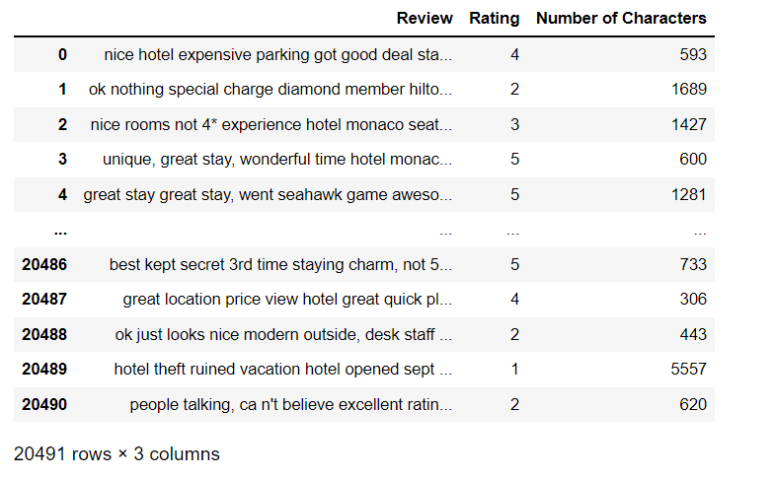
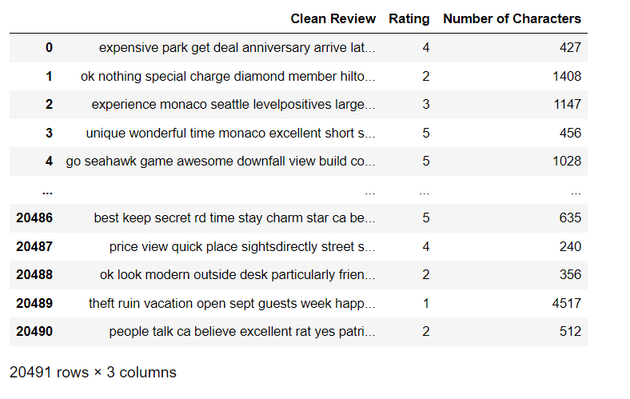
5.1 Before Pre Processing :
5.2 After Pre Processing :

Slide 27
6. Sentiment Analysis using TextBlob

Slide 28
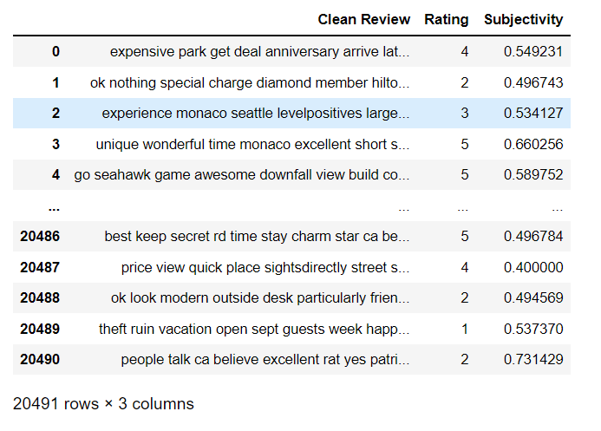
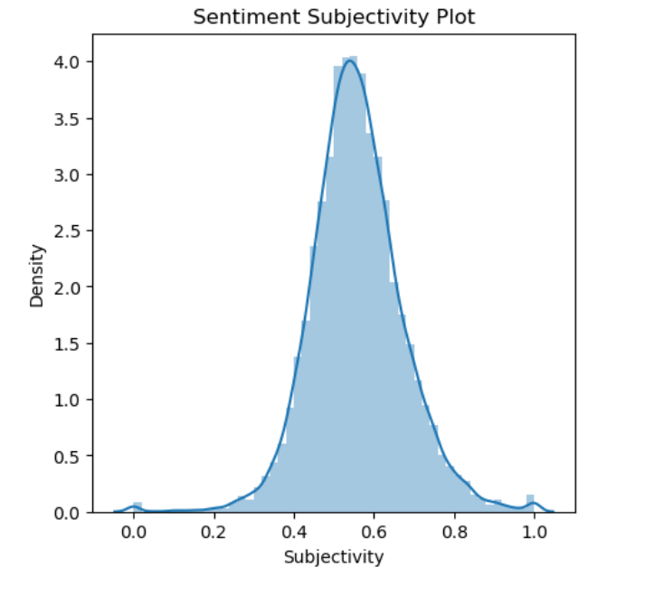
6.1 Calculating Subjectivity :
It talks about how subjective the opinion is
You can see that the Subjectivity mainly ranges between 0 and 1 but the highest Subjectivity ranges between 0.4 to 0.8. This indicates that the majority of the Customers had given Good Opinions about Hotel.

Slide 29
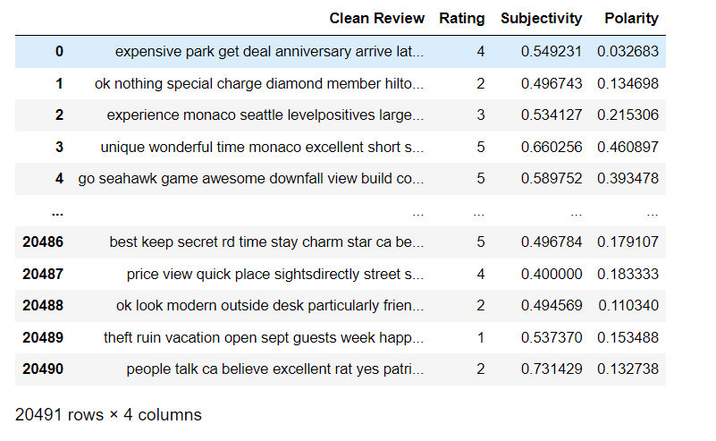
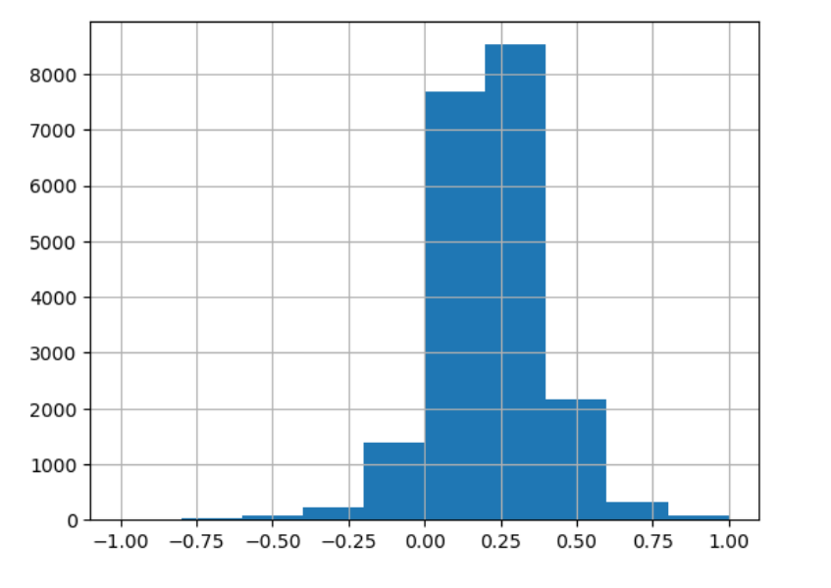
6.2 Calculating Polarity Score :
It talks about how positive or negative the opinion is
You can see that the polarity mainly ranges between -1 and 1 but the highest polarity ranges between 0.00 to 0.50. This indicates that the majority of the Hotel Reviews are Positive.

Slide 30
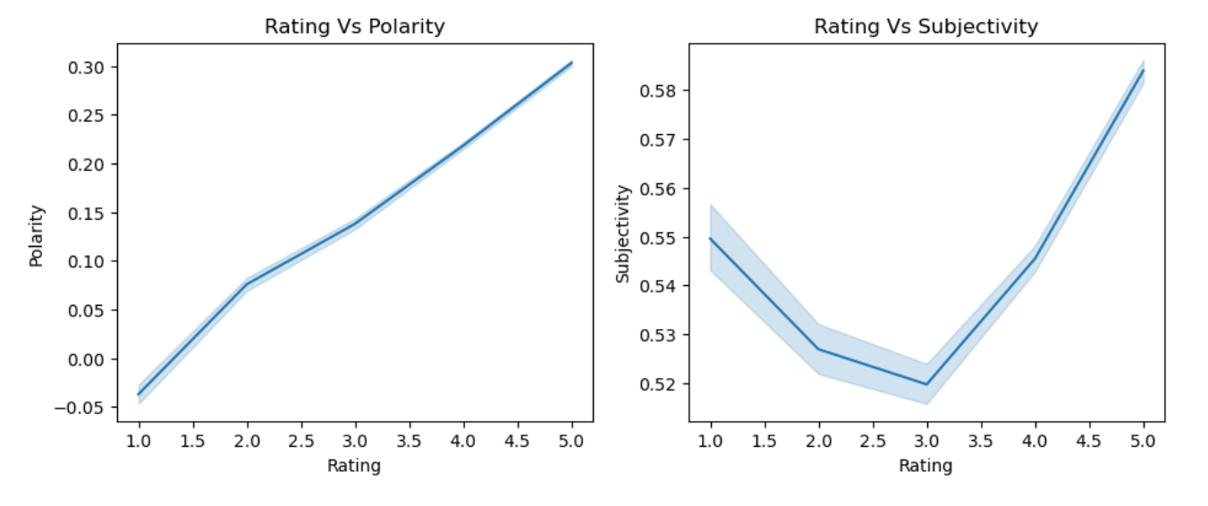
6.3 Line Plot For Textblob :

Slide 31
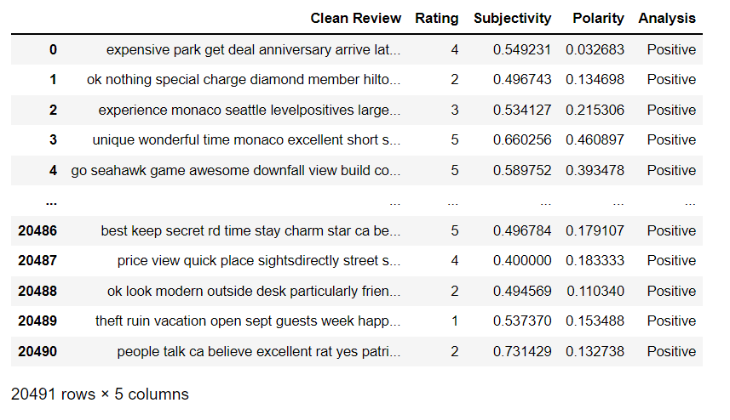
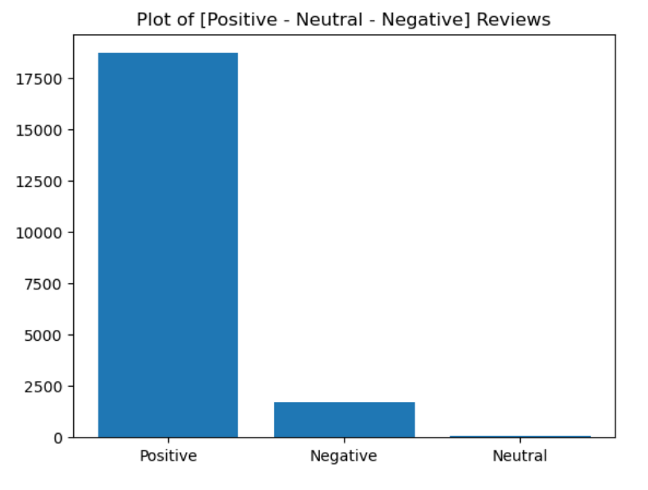
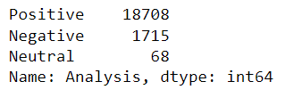
6.4 Analysing the Reviews :
Yep 91.3 % of Reviews is Positive with only 8.4 % of Negative and 0.3 % of Neutral.

Slide 32
7. Sentiment Analysis using VADER

Slide 33
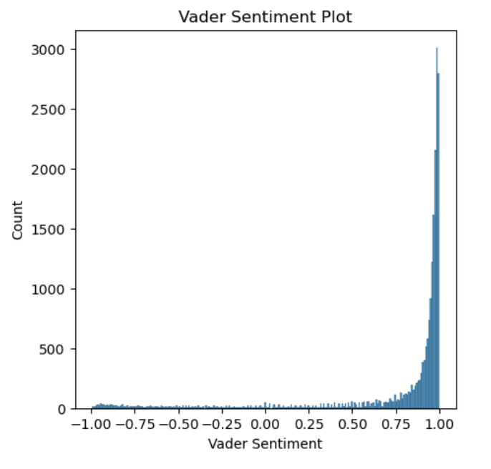
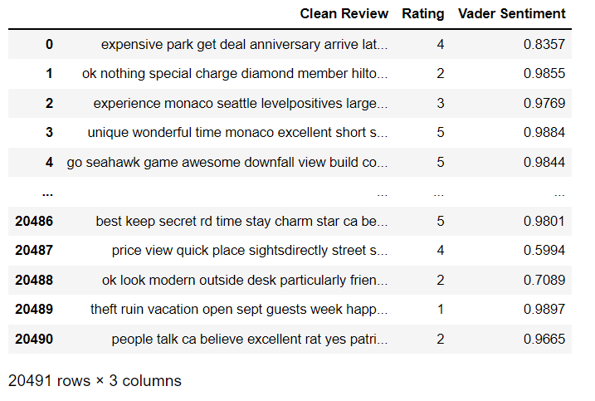
7.1 Calculating Vader Sentiment :
You can see that the Vader Sentiment mainly ranges between -1 and 1 but the highest Vader ranges between 0.75 to 1. This indicates that the majority of the Customers had given Good Opinions and positive Reviews about Hotel.

Slide 34
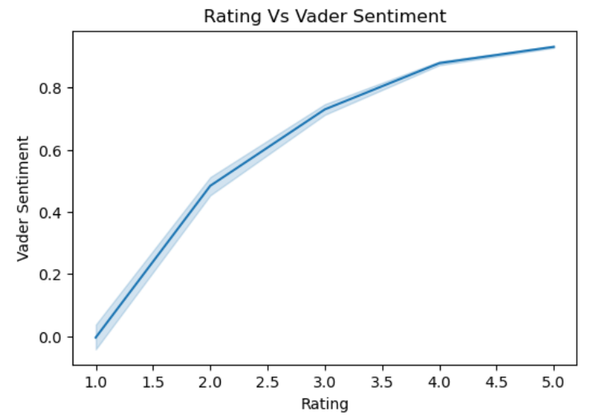
7.2 Line Plot for VADER :

Slide 35
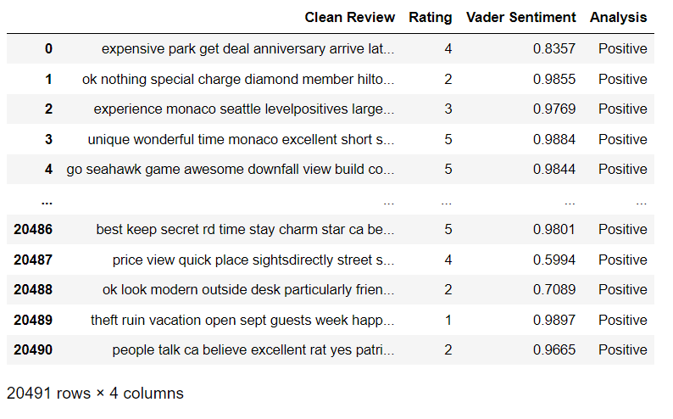
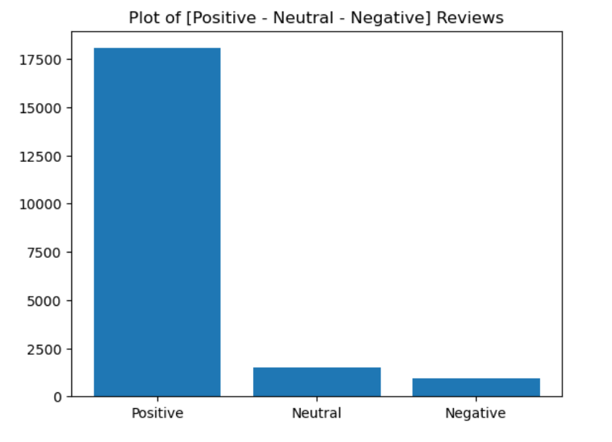
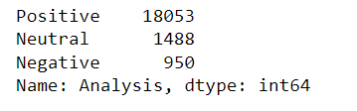
7.3 Analysing the Reviews :
Yep 88.1 % of Reviews is Positive with only 4.6 % of Negative and 7.3 % of Neutral.

Slide 36
8. Visual Representation of TextBlob & VADER

Slide 37
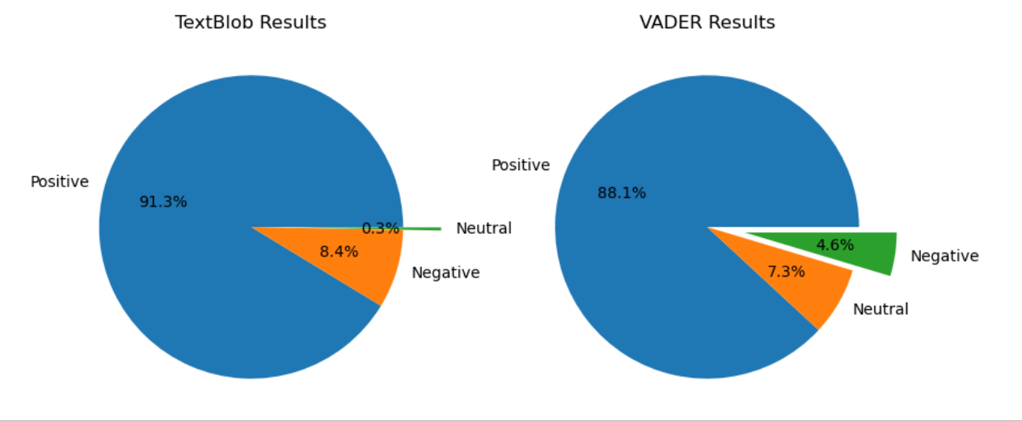
As we can see from above pie chart comparing both textblob and VADER the best Analysis is Textblob analysis in which we got the result of most Positive Reviews of 91.3 %.

Slide 38
9. Model Building

Slide 39
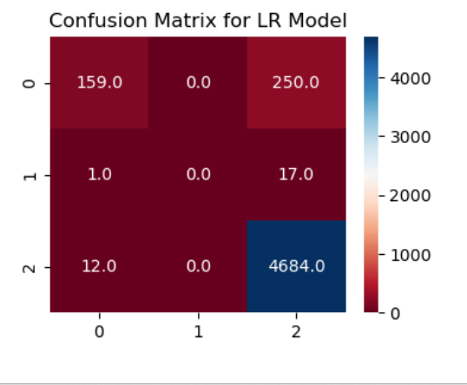
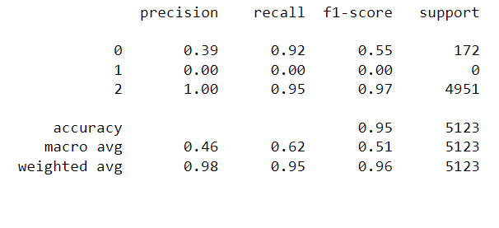
MODEL 1 - Logistic Regression

Slide 40
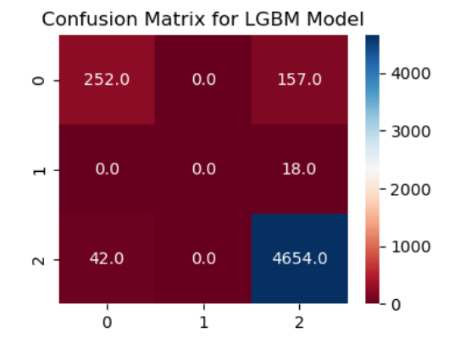
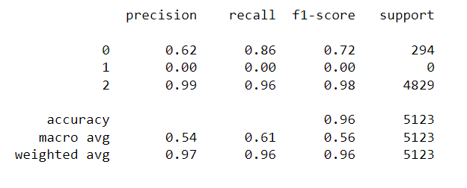
MODEL 2 - LightGBM Classifier Model

Slide 41
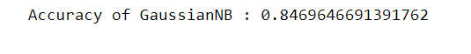
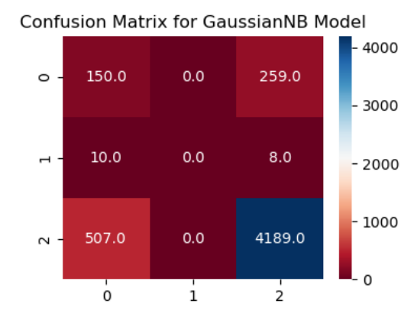
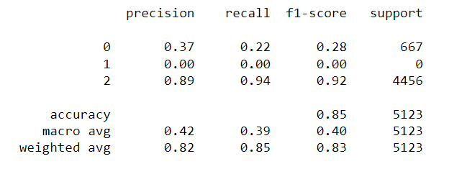
MODEL 3 - Gaussian Naive Bayes Model

Slide 42
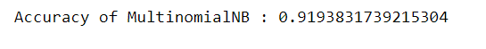
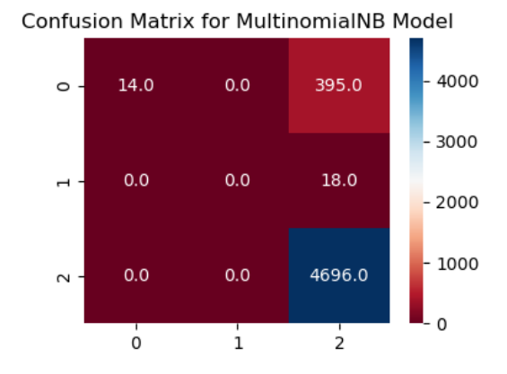
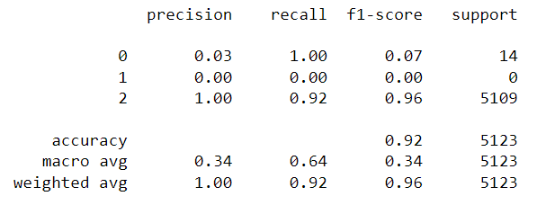
MODEL 4 - Multinomial Naive Bayes Model

Slide 43
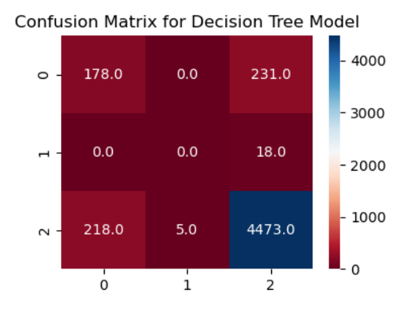
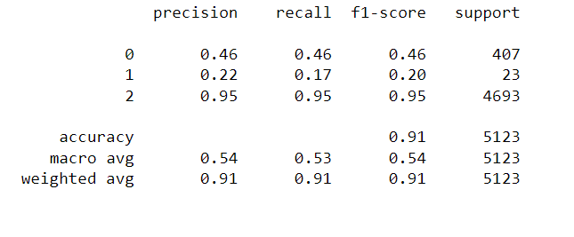
MODEL 5 - Decision Tree Classifier Model

Slide 44
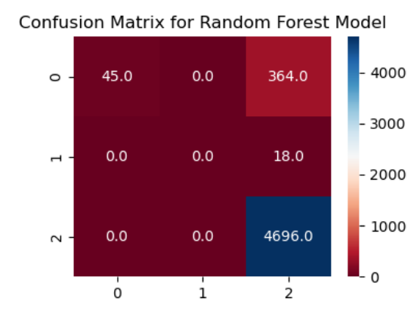

MODEL 6 - Random Forest Classifier Model

Slide 45



MODEL 7 - KNeighbors Classifier Model

Slide 46



MODEL 8 - AdaBoost Classifier Model

Slide 47
10. Conclusion

Slide 48


From the above bar plot as we can see that comparing all models the best accuracy model that we have got is LGBM Classifier with 95.76%

Slide 49
11. Deployment

Slide 50


11.1 Home Page :

Slide 51




Slide 52



Slide 53


11.2 Sentiment Analysis Page :
A) For Textblob :

Slide 54




Slide 55


B) For VADER :

Slide 56



Slide 57


11.3 Prediction Page :
A) For Text Analysis
Positive Sentiment 😀
Negative Sentiment 😔

Slide 58

B) Check KeyWords

Slide 59

C) Word Cloud

Slide 60
Challenges Faced & Overcome of it :
Faced a issue during deployment we got NLTK issue that was not supporting the current python version.
Overcome : we were using latest version of python but we updated the lower python version.

Slide 61
THANK YOU

